Slide 1

Security Assessments
FITSP-A
Module 5
Notes:
Special Publication 800-53A is a companion guideline to Special Publication 800-53,
Recommended Security Controls for Federal Information Systems and Organizations. Each publication provides guidance for implementing specific steps in the Risk Management Framework (RMF). Special Publication 800-53 covers Step 2 in the RMF, security control selection (i.e., determining what security controls are needed to manage risks to organizational operations and assets, individuals, other organizations, and the Nation). Special Publication 800- 53A covers RMF Step 4, security control assessment, and RMF Step 6, continuous monitoring, and provides guidance on the security assessment process.

Slide 2
Notes:
An assessment object for each security control, which identifies the specific control items being assessed and testing techniques, can be found in which document?
NIST Special Publication 800-37 Revision 1, Guide for Applying the Risk Management Framework to Federal Information Systems
NIST Special Publication 800-53 Revision 3, Recommended Security Controls for Federal Information Systems and Organizations
NIST Special Publication 800-53A Revision 1, Guide for Assessing the Security Controls in Federal Information Systems and Organizations
All of the above
Examples of control activities that are specific protection-related pursuits or actions that involve people are all of the following except?
Exercising a contingency plan
Locking user accounts after failed logins
Reviewing audit logs
Moving backups to an offsite location
Which of the following is not one of the phases of the SDLC?
Implementation
Innovation
Disposition (Disposal)
Development/Acquisition
Which of the following is a valid assessment method?
Test
Examine
Interview
All of the above
Which of the following statements about system security assessments is false?
System assessments are typically conducted by information systems developers, systems integrators, information system owners, common control providers, assessors, auditors, Inspectors General, and the information security staffs of organizations.
System assessments are used to compile and evaluate the evidence needed by organizational officials to determine how effective the security controls employed in the information system are likely to be in mitigating risk.
Assessors obtain the required evidence during the assessment process whereupon they can authorize the risk acceptance.
None of the above

Slide 3
Leadership
Security control assessments are not about checklists, simple pass-fail results, or generating paperwork to pass inspections or audits, rather, security controls assessments are the principal vehicle used to verify that the implementers and operators of information systems are meeting their stated security goals and objectives.
      Joint Task Force
      Transformation Initiative
      From SP800-53a

Slide 4
FITSP-A Exam Module Objectives
Risk Assessment
  Ensure periodic assessment of risk to organization
Security Assessments and Authorization
  Direct processes that facilitate the periodic assessment of the security controls in organizational information systems to determine if the controls are effective in their application
Notes:
Security controls are the management, operational, and technical safeguards or countermeasures prescribed for an information system to protect the confidentiality, integrity (including non-repudiation and authenticity), and availability of the system and its information. Once employed within an information system, security controls are assessed to provide the information necessary to determine their overall effectiveness; that is, the extent to which the controls are implemented correctly, operating as intended, and producing the desired outcome with respect to meeting the security requirements for the system. Understanding the overall effectiveness of the security controls implemented in the information system and its environment of operation is essential in determining the risk to the organization’s operations and assets, to individuals, to other organizations, and to the Nation resulting from the use of the system.

Slide 5
Security Assessment Module Overview
Section A: Assessment Foundation
  RMF Tasks for Step 4
  Assessments Within the SDLC
  Security Content Automation Protocol
  Strategy for Conducting Security Control Assessments
  Building an Effective Assurance Case
  Assessment Procedures
Section B: Planning for Assessments
  Preparing for Security Control Assessments
  Developing Security Assessment Plans
Conducting and Reporting
  Conducting Security Control Assessments
  Analyzing Security Assessment Report Results
Notes:
Special Publication 800-53A, Guide for Assessing the Security Controls in Federal Information Systems and Organizations, is written to facilitate security control assessments conducted within an effective risk management framework. The assessment results provide organizational officials with:
Evidence about the effectiveness of security controls in organizational information systems
An indication of the quality of the risk management processes employed within the organization
Information about the strengths and weaknesses of information systems which are supporting organizational missions and business functions in a global environment of sophisticated and changing threats.
The findings produced by assessors are used to determine the overall effectiveness of the security controls associated with an information system and to provide credible and meaningful inputs to the organization’s risk management process. A well-executed assessment helps to:
Determine the validity of the security controls contained in the security plan and subsequently employed in the information system and its environment of operation.
Facilitate a cost-effective approach to correcting weaknesses or deficiencies in the system in an orderly and disciplined manner consistent with organizational mission/business needs.

Slide 6
Assessment Foundation
Section A

Slide 7
RMF Step 4 – Assess Security Controls
Assessment Preparation
Security Control Assessment
Security Assessment Report
Remediation Actions
Notes:
Assessment Preparation
Task 4-1: Develop, review, and approve a plan to assess the security controls.
Primary Responsibility: Security Control Assessor.
Supporting Roles: Authorizing Official or Designated Representative; Chief Information Officer; Senior Information Security Officer; Information System Owner or Common Control Provider; Information Owner/Steward; Information System Security Officer.
SDLC Phase: Development/Acquisition; Implementation.
References: NIST Special Publication 800-53A.
Security Control Assessment
Task 4-2: Assess the security controls in accordance with the assessment procedures defined in the security assessment plan.
Primary Responsibility: Security Control Assessor.
Supporting Roles: Information System Owner or Common Control Provider; Information Owner/Steward; Information System Security Officer.
SDLC Phase: Development/Acquisition; Implementation.
References: NIST Special Publication 800-53A.

Slide 8
Notes:
Security Assessment Report
Task 4-3: Prepare the security assessment report documenting the issues, findings, and recommendations from the security control assessment.
Primary Responsibility: Security Control Assessor.
Supporting Roles: Information System Owner or Common Control Provider; Information System Security Officer.
SDLC Phase: Development/Acquisition; Implementation.
References: NIST Special Publication 800-53A
Remediation Actions
Task 4-4: Conduct initial remediation actions on security controls based on the findings and recommendations of the security assessment report and reassess remediated control(s), as appropriate.
Primary Responsibility: Information System Owner or Common Control Provider; Security Control Assessor.
Supporting Roles: Authorizing Official or Designated Representative; Chief Information Officer; Senior Information Security Officer; Information Owner/Steward; Information System Security Officer; Information System Security Engineer; Security Control Assessor.
SDLC Phase: Development/Acquisition; Implementation.
References: NIST Special Publication 800-53A

Slide 9
Assessments Within the SDLC
Initiation
Development/Acquisition
  Design and Code Reviews
  Application Scanning
  Regression Testing
Implementation
Operations And Maintenance
  Security Assessments Conducted by
    information system owners, common control providers, information system security officers, independent assessors, auditors, and Inspectors General
Disposition (Disposal)
Notes:
Security assessments can be effectively carried out at various stages in the system development life cycle to increase the grounds for confidence that the security controls employed within or inherited by an information system are effective in their application. This publication provides a comprehensive set of assessment procedures to support security assessment.
Development/Acquisition:
Security assessments are routinely conducted by information system developers and system integrators during the development/acquisition and implementation phases of the life cycle to help ensure that the required security controls for the system are properly designed and developed, correctly implemented, and consistent with the established organizational information security architecture.
Assessment activities in the development phase included, for example, design and code reviews, application scanning, and regression testing.
Security weaknesses and deficiencies identified early in the system development life cycle can be resolved more quickly and in a much more cost-effective manner before proceeding to subsequent phases in the life cycle. The objective is to identify the information security architecture and security controls up front and to ensure that the system design and testing validate the implementation of these controls.

Slide 10
Notes:
Regression testing is any type of software testing that seeks to uncover new software bugs, or regressions, in existing functional and non-functional areas of a system after changes, such as enhancements, patches or configuration changes, have been made to them.
The intent of regression testing is to ensure that a change, such as a bug fix, did not introduce new faults. One of the main reasons for regression testing is to determine whether a change in one part of the software affects other parts of the software.
Common methods of regression testing include rerunning previously run tests and checking whether program behavior has changed and whether previously fixed faults have re-emerged. Regression testing can be used to test a system efficiently by systematically selecting the appropriate minimum set of tests needed to adequately cover a particular change.
Operations and Maintenance:
Security assessments are also routinely conducted by information system owners, common control providers, information system security officers, independent assessors, auditors, and Inspectors General during the operations and maintenance phase of the life cycle to ensure that security controls are effective and continue to be effective in the operational environment where the system is deployed.
For example, organizations assess all security controls employed within and inherited by the information system during the initial security authorization. Subsequent to the initial authorization, the organization assesses the security controls (including management, operational, and technical controls) on an ongoing basis.
Disposal:
Finally, at the end of the life cycle, security assessments are conducted as part of ensuring that important organizational information is purged from the information system prior to disposal.

Slide 11
Security Content Automation Protocol
SCAP Compliments Security Assessments
Automates Monitoring & Reporting
  Vulnerabilities
  Configurations
Open Checklist Interactive Language
  Partially Automated Monitoring
  Express Determination Statements in a Format Compatible with SCAP
Notes:
NIST also initiated the Security Content Automation Protocol (SCAP) project that supports and complements the approach for achieving consistent, cost-effective security control assessments.
The primary purpose of the SCAP is to improve the automated application, verification, and reporting of information technology product-specific security configuration settings, enabling organizations to identify and reduce the vulnerabilities associated with products that are not configured properly.
As part of this initiative, an Open Checklist Interactive Language (OCIL) provides the capability to express the determination statements in the assessment procedures in a framework that will establish interoperability with the validated tool sets supporting SCAP.

Slide 12
Strategy for Conducting Security Control Assessments
Maximize Use of Common Controls
Share Assessment Results
Develop Organization-wide Procedures
Provide Organization-wide Tools, Template, Techniques
Notes:
Maximizing the number of common controls employed within an organization:
Significantly reduces the cost of development, implementation, and assessment of security controls
Allows organizations to centralize security control assessments and to amortize the cost of those assessments across all information systems organization-wide
Increases overall security control consistency.
An organization-wide approach to identifying common controls early in the application of the RMF facilitates a more global strategy for assessing those controls and sharing essential assessment results with information system owners and authorizing officials.
The sharing of assessment results among key organizational officials across information system boundaries has many important benefits including:
Providing the capability to review assessment results for all information systems and to make organization-wide, mission/business-related decisions on risk mitigation activities according to organizational priorities, the security categorization of the information systems supporting the organization, and risk assessments;

Slide 13
Notes:
Providing a more global view of systemic weaknesses and deficiencies occurring in information systems across the organization
Providing an opportunity to develop organization-wide solutions to information security problems
Increasing the organization’s knowledge base regarding threats, vulnerabilities, and strategies for more cost-effective solutions to common information security problems
Organizations can also promote a more focused and cost-effective assessment process by:
Developing more specific assessment procedures that are tailored for their specific organizational environments of operation and requirements (instead of relegating these tasks to each security control assessor or assessment team)
Providing organization-wide tools, templates, and techniques to support more consistent assessments throughout the organization

Slide 14
Building an Effective Assurance Case
Compiling and Presenting Evidence
Basis for Determining Effectiveness of Controls
Product Assessments
Systems Assessment
Risk Determination
Notes:
Building an effective assurance case for security control effectiveness is a process that involves:
Compiling evidence from a variety of activities conducted during the system development life cycle that the controls employed in the information system are implemented correctly, operating as intended, and producing the desired outcome with respect to meeting the security requirements of the system
Presenting this evidence in a manner that decision makers are able to use effectively in making risk-based decisions about the operation or use of the system. The evidence described above comes from the implementation of the security controls in the information system and inherited by the system (i.e., common controls) and from the assessments of that implementation
An assurance case is a body of evidence organized into an argument demonstrating that some claim about an information system is assured. An assurance case is needed when it is important to show that a system exhibits some complex property such as safety, security, or reliability. Additional information can be obtained at …
https://buildsecurityin.us-cert.gov/daisy/bsi/articles/knowledge/assurance/643.html

Slide 15
Notes:
Assessors obtain the required evidence during the assessment process to allow the appropriate organizational officials to make objective determinations about the effectiveness of the security controls and the overall security state of the information system.
Product assessments (also known as product testing, evaluation, and validation) are typically conducted by independent, third-party testing organizations. These assessments examine the security functions of products and established configuration settings.
System assessments are typically conducted by information systems developers, systems integrators, information system owners, common control providers, assessors, auditors, Inspectors General, and the information security staffs of organizations. The assessors or assessment teams bring together available information about the information system such as the results from individual component product assessments, if available, and conduct additional system-level assessments using a variety of methods and techniques.
System assessments are used to compile and evaluate the evidence needed by organizational officials to determine how effective the security controls employed in the information system are likely to be in mitigating risk.

Slide 16
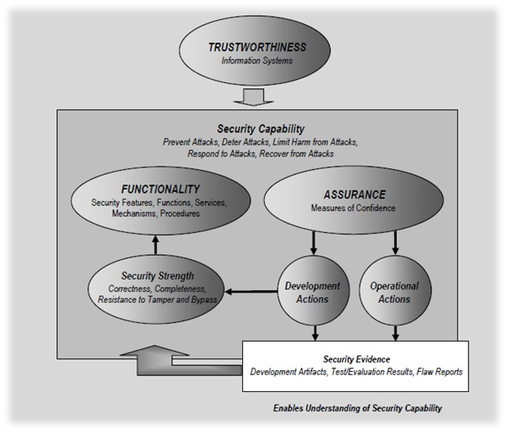
Trustworthiness
Notes:
Whether information systems are deployed to support the operations of the national air traffic control system, a nuclear power plant providing electricity for a large city, a major financial institution, or the military services and war fighters, the systems must be reliable, trustworthy, and resilient. Reliability, trustworthiness, resilience are also important characteristics for the day-today mission/business operations of organizations supported, for example, by email systems and web servers.
Trustworthiness with respect to information systems, expresses the degree to which the systems (including the information technology products that are used to build those systems) can be expected to preserve the confidentiality, integrity, and availability of the information being processed, stored, or transmitted by the systems across the full range of threats. Trustworthy information systems are systems that are believed to be capable of operating within defined levels of risk despite the environmental disruptions, human errors, structural failures, and purposeful attacks that are expected to occur in their environments of operation. Information security plays an important part in achieving trustworthy information systems—systems that have the reliability to successfully carry out assigned missions/business functions under conditions of stress and uncertainty and in specified environments.

Slide 17
Assessment Procedures
Assessment Objectives
Determination Statements
Assessment Methods
Assessment Objects
Assessment Findings
Notes:
An assessment procedure consists of a set of assessment objectives, each with an associated set of potential assessment methods and assessment objects. An assessment objective includes a set of determination statements related to the security control under assessment.
The determination statements are linked to the content of the security control (i.e., the security control functionality) to ensure traceability of assessment results back to the fundamental control requirements. The application of an assessment procedure to a security control produces assessment findings. These assessment findings reflect, or are subsequently used, to help determine the overall effectiveness of the security control.
Assessment objects identify the specific items being assessed and include specifications, mechanisms, activities, and individuals. Specifications are the document-based artifacts (e.g., policies, procedures, plans, system security requirements, functional specifications, and architectural designs) associated with an information system. Mechanisms are the specific hardware, software, or firmware safeguards and countermeasures employed within an information system. Activities are the specific protection-related pursuits or actions supporting an information system that involve people (e.g., conducting system backup operations, monitoring network traffic, exercising a contingency plan). Individuals, or groups of individuals, are people applying the specifications, mechanisms, or activities described above.

Slide 18
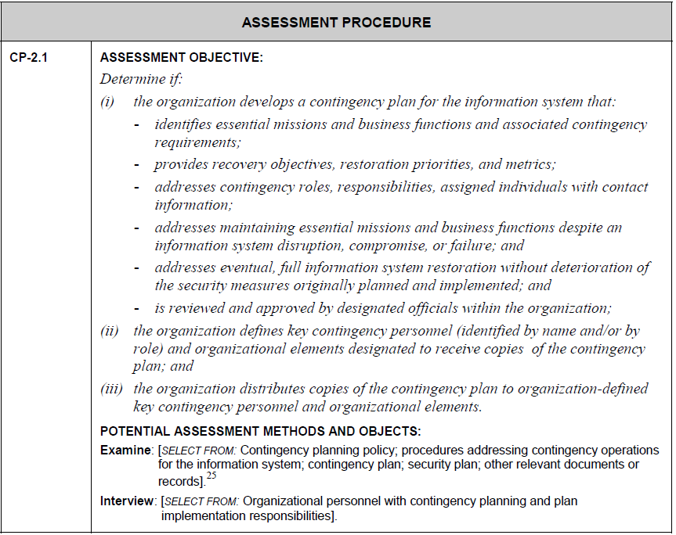
Objective Determination Statement
Notes:
An assessment procedure consists of a set of assessment objectives, each with an associated set of potential assessment methods and assessment objects. An assessment objective includes a set of determination statements related to the security control under assessment.

Slide 19
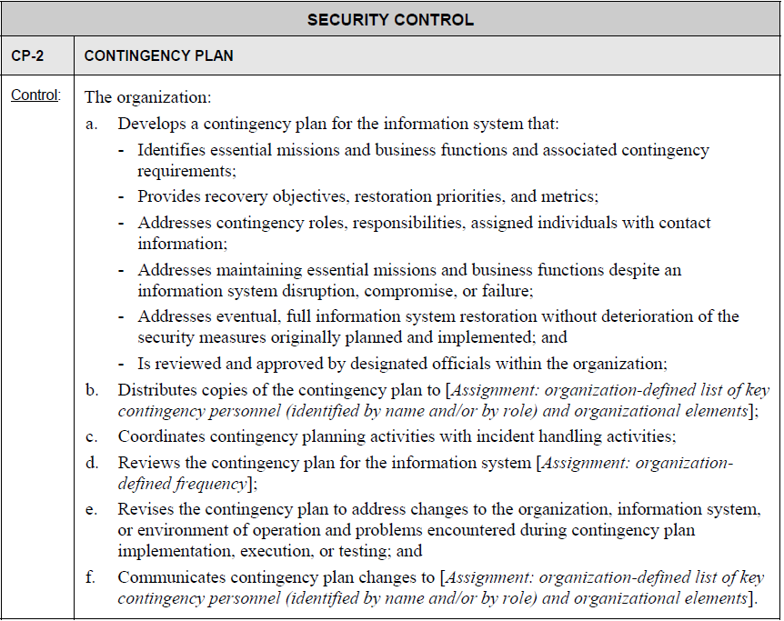
Control Statement
Notes:
The determination statements are linked to the content of the security control (i.e., the security control functionality) to ensure traceability of assessment results back to the fundamental control requirements. The application of an assessment procedure to a security control produces assessment findings. These assessment findings reflect, or are subsequently used, to help determine the overall effectiveness of the security control.
The determination statement provides traceability to the security control statement in the SP 800-53 catalog.

Slide 20
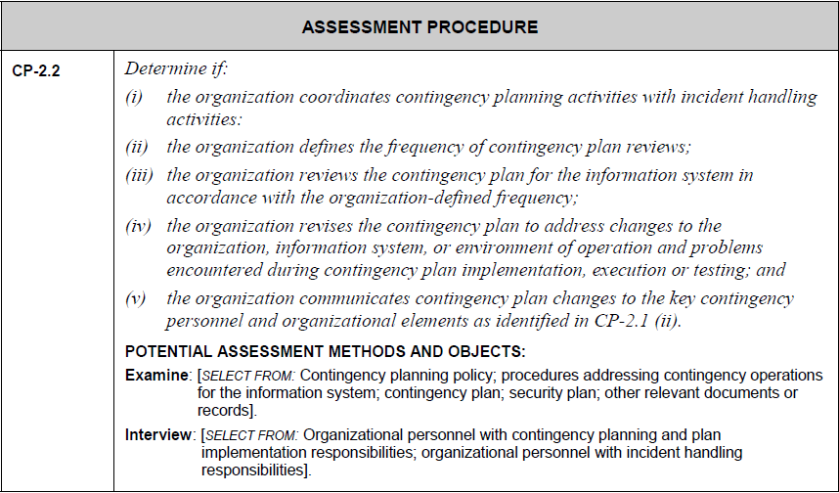
Subsequent Objectives
Notes:
The first assessment objective for CP-2 is derived from the basic control statement. Potential assessment methods and objects are added to the assessment procedure. In a similar manner, the second assessment objective and potential assessment methods and objects for CP-2 are established.
The assessment objectives within a particular assessment procedure are numbered sequentially (e.g., CP-2.1,…, CP-2.n). If the security control has any enhancements, assessment objectives are developed for each enhancement using the same process as for the base control. The resulting assessment objectives within the assessment procedure are numbered sequentially (e.g., CP-2(1).1 indicating the first assessment objective for the first enhancement for security control CP-2).

Slide 21
Assessment Methods
Examine
Interview
Test
Attributes
  Depth (Basic, Focused, Comprehensive)
  Coverage (Basic, Focused, Comprehensive)
  Determined by Assurance Requirements
  Defined by Organization
Notes:
Assessment methods define the nature of the assessor actions and include examine, interview, and test.
The examine method is the process of reviewing, inspecting, observing, studying, or analyzing one or more assessment objects (i.e., specifications, mechanisms, or activities). The purpose of the examine method is to facilitate assessor understanding, achieve clarification, or obtain evidence.
The interview method is the process of holding discussions with individuals or groups of individuals within an organization to once again, facilitate assessor understanding, achieve clarification, or obtain evidence.
The test method is the process of exercising one or more assessment objects (i.e., activities or mechanisms) under specified conditions to compare actual with expected behavior. In all three assessment methods, the results are used in making specific determinations called for in the determination statements and thereby achieving the objectives for the assessment procedure.
The assessment methods have a set of associated attributes, depth and coverage, which help define the level of effort for the assessment. These attributes are hierarchical in nature, providing the means to define the rigor and scope of the assessment for the increased assurances that may be needed for some information systems.

Slide 22
Assessment Objects
Specifications (Artifacts)
Mechanisms (Components of an IS)
Activities (Actions)
Individuals
Notes:
Assessment objects identify the specific items being assessed and include specifications, mechanisms, activities, and individuals.
Specifications are the document-based artifacts (e.g., policies, procedures, plans, system security requirements, functional specifications, and architectural designs) associated with an information system.
Mechanisms are the specific hardware, software, or firmware safeguards and countermeasures employed within an information system.
Activities are the specific protection-related pursuits or actions supporting an information system that involve people (e.g., conducting system backup operations, monitoring network traffic, exercising a contingency plan).
Individuals, or groups of individuals, are people applying the specifications, mechanisms, or activities described above.

Slide 23
Benefit of Repeatable & Documented Methods
Provide Consistency and Structure
Minimize Testing Risks
Expedite Transition Of New Staff
Address Resource Constraints
Reuse Resources
Decrease Time Required
Cost Reduction
Notes:
A repeatable and documented security assessment methodology is beneficial in that it can:
Provide consistency and structure to security testing, which can minimize testing risks.
Expedite the transition of new assessment staff.
Address resource constraints associated with security assessments.
Because information security assessment requires resources such as time, staff, hardware, and software, resource availability is often a limiting factor in the type and frequency of security assessments.
Evaluating the types of security tests and examinations the organization will execute, developing an appropriate methodology, identifying the resources required, and structuring the assessment process to support expected requirements can mitigate the resource challenge.
This gives the organization the ability to
reuse pre-established resources such as trained staff and standardized testing platforms;
decreases time required to conduct the assessment and the need to purchase testing equipment and software;
and reduces overall assessment costs.

Slide 24
Notes:
The depth attribute addresses the rigor and level of detail in the examination, interview, and testing processes. Values for the depth attribute include basic, focused, and comprehensive.
The coverage attribute addresses the scope or breadth of the examination, interview, and testing processes including the number and type of specifications, mechanisms, and activities to be examined or tested and the number and types of individuals to be interviewed. Similar to the depth attribute, values for the coverage attribute include basic, focused, and comprehensive.
The appropriate depth and coverage attribute values for a particular assessment method are based on the assurance requirements specified by the organization. As assurance requirements increase with regard to the development, implementation, and operation of security controls within or inherited by the information system, the rigor and scope of the assessment activities (as reflected in the selection of assessment methods and objects and the assignment of depth and coverage attribute values), tend to increase as well.
Although not explicitly noted with each identified assessment method in the assessment procedure, the attribute values of depth and coverage are assigned by the organization and applied by the assessor/assessment team in the execution of the assessment method against an assessment object.

Slide 25
Knowledge Check
What task must the assessor complete before conducting a security assessment?
  After?
What type of software testing that seeks to uncover new software bugs in existing functional and non-functional areas of a system after changes have been made to them?
What is a term used to describe a body of evidence, organized into an argument, demonstrating that some claim about an information system is assured?
An assessment procedure consists of a set of assessment ___________, each with an associated set of potential assessment ___________and assessment ___________. An assessment objective includes a set of ___________statements related to the security control under assessment.

Slide 26
Planning for Assessments
Section B

Slide 27
Preparing for the Process of
Security Control Assessments
Understanding Organization’s Operations
Understanding Information System Structure
Understanding of Security Controls being Assessed
Identifying Organizational Entities Responsible for Development and Implementation of Common Controls
Identifying Points of Contact
Obtaining Artifacts
Obtaining Previous Assessment Results
Establishing Rules of Engagement
Developing a Security Assessment Plan
Notes:
Establishing an appropriate set of expectations before, during, and after the assessment is paramount to achieving an acceptable outcome—that is, producing information necessary to help the authorizing official make a credible, risk-based decision on whether to place the information system into operation or continue its operation.
Thorough preparation by the organization and the assessors is an important aspect of conducting effective security control assessments. Preparatory activities address a range of issues relating to the cost, schedule, and performance of the assessment.
Security control assessors/assessment teams begin preparing for the assessment by:
Obtaining a general understanding of the organization’s operations (including mission, functions, and business processes) and how the information system that is the subject of the security control assessment supports those organizational operations;
Obtaining an understanding of the structure of the information system (i.e., system architecture);
Obtaining a thorough understanding of the security controls being assessed (including system-specific, hybrid, and common controls);

Slide 28
Notes:
Identifying the organizational entities responsible for the development and implementation of the common controls (or the common portion of hybrid controls) supporting the information system;
Establishing appropriate organizational points of contact needed to carry out the security control assessment;
Obtaining artifacts needed for the security control assessment (e.g., policies, procedures, plans, specifications, designs, records, administrator/operator manuals, information system documentation, interconnection agreements, previous assessment results);
Obtaining previous assessment results that may be appropriately reused for the security control assessment (e.g., Inspector General reports, audits, vulnerability scans, physical security inspections, prior assessments, developmental testing and evaluation, vendor flaw remediation activities , ISO/IEC 15408 [Common Criteria] evaluations);
Meeting with appropriate organizational officials to ensure common understanding for assessment objectives and the proposed rigor and scope of the assessment; and
Developing a security assessment plan.

Slide 29
Gathering Background Information
Security Policies
Implementing Procedures
Responsible Entities
Materials Associated with Implementation and Operation of Security Controls
Objects to be Assessed
Notes:
In preparation for the assessment of security controls, the necessary background information is assembled and made available to the assessors or assessment team. To the extent necessary to support the specific assessment, the organization identifies and arranges access to:
elements of the organization responsible for developing, documenting, disseminating, reviewing, and updating all security policies and associated procedures for implementing policy-compliant controls;
the security policies for the information system and any associated implementing procedures;
individuals or groups responsible for the development, implementation, operation, and maintenance of security controls;
any materials (e.g., security plans, records, schedules, assessment reports, after-action reports, agreements, authorization packages) associated with the implementation and operation of security controls;
the objects to be assessed.
The availability of essential documentation as well as access to key organizational personnel and the information system being assessed are paramount to a successful assessment of the security controls.

Slide 30
Selecting Security Control Assessors
Technical Expertise
  Specific Hardware
  Software
  Firmware
Level of Independence
  Impartiality
  Determined by Authorizing Official
  Based on Categorization
Independent Security Control Assessment Services
  Contracted to Outside Entity; or
  Obtained within Organization
Notes:
Organizations consider both the technical expertise and level of independence required in selecting security control assessors. Organizations ensure that security control assessors possess the required skills and technical expertise to successfully carry out assessments of system specific, hybrid, and common controls. This includes knowledge of and experience with the specific hardware, software, and firmware components employed by the organization. An independent assessor is any individual or group capable of conducting an impartial assessment of security controls employed within or inherited by an information system. Impartiality implies that assessors are free from any perceived or actual conflicts of interest with respect to the development, operation, and/or management of the information system or the determination of security control effectiveness.
The authorizing official or designated representative determines the required level of independence for security control assessors based on the results of the security categorization process for the information system and the ultimate risk to organizational operations and assets, individuals, other organizations, and the Nation. The authorizing official determines if the level of assessor independence is sufficient to provide confidence that the assessment results produced are sound and can be used to make a risk-based decision on whether to place the information system into operation or continue its operation.
Independent security control assessment services can be obtained from other elements within the organization or can be contracted to a public or private sector entity outside of the organization.

Slide 31
Developing Security Assessment Plans
Determine Which Security Controls/Control Enhancements
Select Appropriate Assessment Procedures
Tailor Assessment Procedures
Address Controls that are Not Sufficiently Covered
Optimize Assessment Procedures
Obtain Approvals to Execute the Plan
Notes:
The security assessment plan provides the objectives for the security control assessment and a detailed roadmap of how to conduct such an assessment. The following steps are considered by assessors in developing plans to assess the security controls in organizational information systems or inherited by those systems:
Determine which security controls/control enhancements are to be included in the assessment based upon the contents of the security plan and the purpose/scope of the assessment;
Select the appropriate assessment procedures to be used during the assessment based on the security controls and control enhancements that are to be included in the assessment;
Tailor the selected assessment procedures (e.g., select appropriate assessment methods and objects, assign depth and coverage attribute values);
Develop additional assessment procedures to address any security requirements or controls that are not sufficiently covered by Special Publication 800-53;
Optimize the assessment procedures to reduce duplication of effort (e.g., sequencing and consolidating assessment procedures) and provide cost-effective assessment solutions; and
Finalize the assessment plan and obtain the necessary approvals to execute the plan.

Slide 32
Conducting & Reporting
Section C

Slide 33
Conducting Security Control Assessments
Execution of Security Assessment Plan
Output Security Assessment Report
May Develop Assessment Summary
Assessment Findings
  Satisfied (S) = Fully Acceptable Result
  Other than Satisfied (O) = Potential Anomalies
Notes:
After the security assessment plan is approved by the organization, the assessor or assessment team executes the plan in accordance with the agreed-upon schedule.
The output and end result of the security control assessment is the security assessment report, which documents the assurance case for the information system and is one of three key documents in the security authorization package developed by information system owners and common control providers for authorizing officials.
The security assessment report includes information from the assessor (in the form of assessment findings) necessary to determine the effectiveness of the security controls employed within or inherited by the information system. The security assessment report is an important factor in an authorizing official’s determination of risk.
Organizations may choose to develop an assessment summary from the detailed findings that are generated by the assessor during the security control assessment. An assessment summary can provide an authorizing official with an abbreviated version a of Security Assessment Report focusing on the highlights of the assessment, synopsis of key findings, and/or recommendations for addressing weaknesses and deficiencies in the security controls.

Slide 34
Notes:
Security control assessment results are documented at the level of detail appropriate for the assessment in accordance with the reporting format prescribed by organizational policy, NIST guidelines, and OMB policy. The reporting format is appropriate for the type of security control assessment conducted (e.g., self-assessments by information system owners and common control providers, independent verification and validation, independent assessments supporting the security authorization process, or independent audits or inspections).
Assessment objectives are achieved by applying the designated assessment methods to selected assessment objects and compiling/producing the evidence necessary to make the determination associated with each assessment objective.
Each determination statement contained within an assessment procedure executed by an assessor produces one of the following findings:
satisfied (S); or
other than satisfied (O).
A finding of satisfied indicates the assessment objective for the control has been met producing a fully acceptable result.
A finding of other than satisfied indicates potential anomalies in the operation or implementation of the control that may need to be addressed by the organization.
Risk determination and acceptance activities are conducted by the organization post assessment as part of the risk management strategy established by the organization. These risk management activities involve the senior leadership of the organization

Slide 35
Analyzing Security Assessment Report Results
Review Weaknesses and Deficiencies in Security Controls
Prioritize correcting the deficiencies based on
  Critical Information Systems
  High Risk Deficiencies
Key Documents Updates
  System Security Plan with Updated Risk Assessment
  Security Assessment Report
  Plan of Action and Milestones
Notes:
By using the labels of satisfied and other than satisfied, the reporting format for the
assessment findings provides visibility for organizational officials into specific weaknesses and deficiencies in security controls within the information system or inherited by the system and facilitates a disciplined and structured approach to mitigating risks in accordance with organizational priorities.
Senior leadership involvement in the mitigation process may be necessary in order to ensure that the organization’s resources are effectively allocated in accordance with organizational priorities, providing resources first to the information systems that are supporting the most critical and sensitive missions for the organization or correcting the deficiencies that pose the greatest degree of risk.
Ultimately, the security control assessment findings and any subsequent mitigation actions (informed by the updated risk assessment) initiated by information system owners or common control providers in collaboration with designated organizational officials trigger updates to the key documents used by authorizing officials to determine the security status of the information system and its suitability for authorization to operate. These documents include the security plan with updated risk assessment, security assessment report, and plan of action and milestones.

Slide 37
Security Assessments
Key Concepts & Vocabulary
Assessments Within the SDLC
Strategy for Conducting Security Control Assessments
Building an Effective Assurance Case
Assessment Procedures
Preparing for Security Control Assessments
Developing Security Assessment Plans
Conducting Security Control Assessments
Analyzing Security Assessment Report Results
Notes:
Artifact
Evidence produced by developers, implementers, operators, assessors, and maintainers during the system development life cycle.
Assurance Case
A body of evidence organized into an argument demonstrating that some claim about an information system is assured. An assurance case is needed when it is important to show that a system exhibits some complex property such as safety, security, or reliability.
Regression Testing
Any type of software testing that seeks to uncover new software bugs, or regressions, in existing functional and non-functional areas of a system after changes, such as enhancements, patches or configuration changes, have been made to them.
Rules of Engagement
How a penetration test needs to run, starting from denying false advertising from testers to how the client can expect to receive the report.
SAR
The output and end result of the security control assessment is the security assessment report, which documents the assurance case for the information system and is one of three key documents in the security authorization package developed by information system owners and common control providers for authorizing officials.

Slide 38
Notes:
Security Assurance
Security assurance is the measure of confidence that the security functionality is implemented correctly, operating as intended, and producing the desired outcome with respect to meeting the security requirements for the system—thus, accurately mediating and enforcing established security policies.
Security Capability
Together, the security functionality and security assurance combine to provide a security capability for organizations, mission/business processes, and information
Systems - a capability necessary to respond to ongoing risks to organizational operations and assets, individuals, other organizations, and the Nation. With regard to increasingly sophisticated and hostile cyber attacks, organizations need an adequate security capability to prevent attacks, deter attacks, respond to attacks (i.e., limiting harm), and restore/recover from attacks.
Security Functionality
Security functionality is typically defined in terms of the security features, functions, mechanisms, services, procedures, and architectures implemented within organizational information systems or the environments in which those systems operate.
Trustworthiness
Trustworthiness, with respect to information systems, expresses the degree to which the systems (including the information technology products that are used to build those systems) can be expected to preserve the confidentiality, integrity, and availability of the information being processed, stored, or transmitted by the systems across the full range of threats. Trustworthy information systems are systems that are believed to be capable of operating within defined levels of risk despite the environmental disruptions, human errors, structural failures, and purposeful attacks that are expected to occur in their environments of operation. Information security plays an important part in achieving trustworthy information systems—systems that have the reliability to successfully carry out assigned missions/business functions under conditions of stress and uncertainty and in specified environments.

Slide 39
Lab Activity 4 –
Building an Assessment Case
Step 1 – Categorize Information System
Step 6 –
Monitor Controls
Step 2 –
Select Controls
Step 5 - Authorize Information System
Step 3 – Implement Controls
Step 4 –
Assess Controls
Notes:
An assessment case represents a worked example of an assessment procedure, identifying the specific actions that an assessor might carry out during the assessment of a security control or control enhancement in an information system.
There is one assessment case per control, covering all assessment objectives from the assessment procedure in Appendix F for that control (both base control and all enhancements).
The assessment case provides an example by experienced assessors of a potential set of specific assessor action steps to accomplish the assessment that were developed with consideration for the list of potential assessment methods and objects, and incorporating the level of coverage and depth to be applied and the specific purpose to be achieved by each assessor action. This additional level of detail in the assessment cases provides assessors with more prescriptive assessment information. Yet, while being more prescriptive, the assessment cases are not intended to restrict assessor flexibility provided as part of the design principles in Special Publication 800-53A. The assessor remains responsible for making the specified determinations and for providing adequate rationale for the determinations made.

Slide 40
Notes:
Please build an assessment case for AC-7.1 Unsuccessful Login Attempts, using the assessment case template and example worksheets from LabActivityWorkingData.xlsx workbook. The following is an example of the specific evidence gathering actions that build the assurance case for AC-11.1. [Use the USGCB as guidance for verifying configuration of specific settings, relating to control AC-7]

Slide 41
Notes:
Which NIST special publication is written to facilitate security control assessments conducted within an effective risk management framework?
SP 800-60 Volume II
SP 800-53
SP 800-53a
SP 800-39
Which of the following is NOT a security testing techniques?
Examine
Review
Interview
Test
What is defined as body of evidence organized into an argument demonstrating that some claim about an information system is assured?
Security Assessment Report
Artifact of Trustworthiness
Assurance Case
Determination Statement
Which statements are linked to the content of the security control (i.e., the security control functionality) to ensure traceability of assessment results back to the fundamental control requirements?
Assessment Objectives
Procedure Statement
Assurance Case
Determination Statement
Which assessment method is the process of reviewing, inspecting, observing, studying, or analyzing one or more assessment objects (i.e., specifications, mechanisms, or activities)?
Review
Examine
Interview
Test
What are the two most important factors in choosing a security control assessor?
Independence/Expertise
Trustworthiness/Experience
Expertise/Trustworthiness
Experience/Independence
Module 5 Security Assessments Post-assessment

Slide 42

Questions?
Next Module: Authorization

